Slide 1




Fradel and Spies Co
Cyclistic Bike-Share
Case Study
Name: Rishita Gupta
Role: Data Analyst
Analyzing Rider Behavior to Drive Membership Growth
24.09.2025

Slide 2


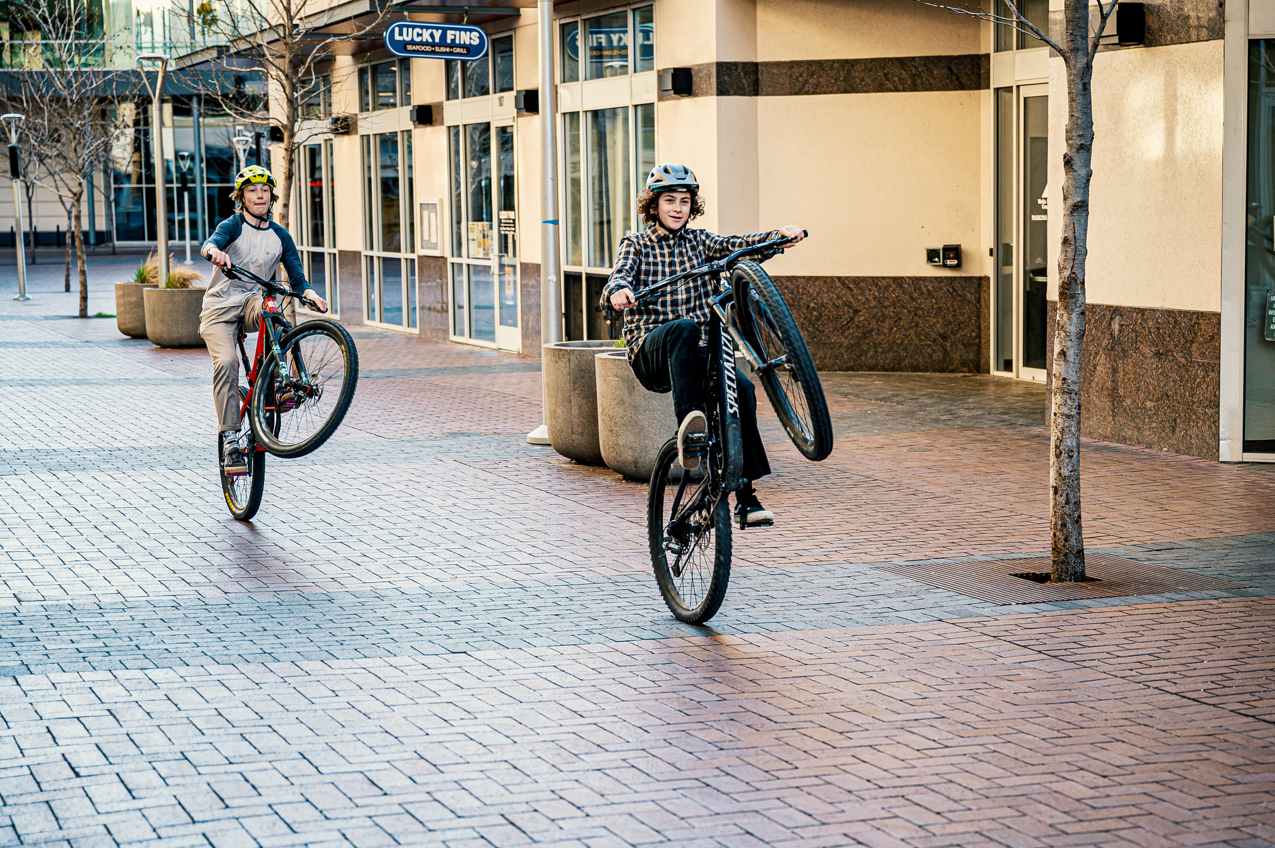
Objective & Approach
Objective
Approach
Understand how casual riders differ from members and find strategies to increase memberships.
Data collection (12 months of trip data).
Data cleaning and preparation (Excel, Python, Power BI).
Visualization and dashboard building.
Insights & recommendations.

Slide 3
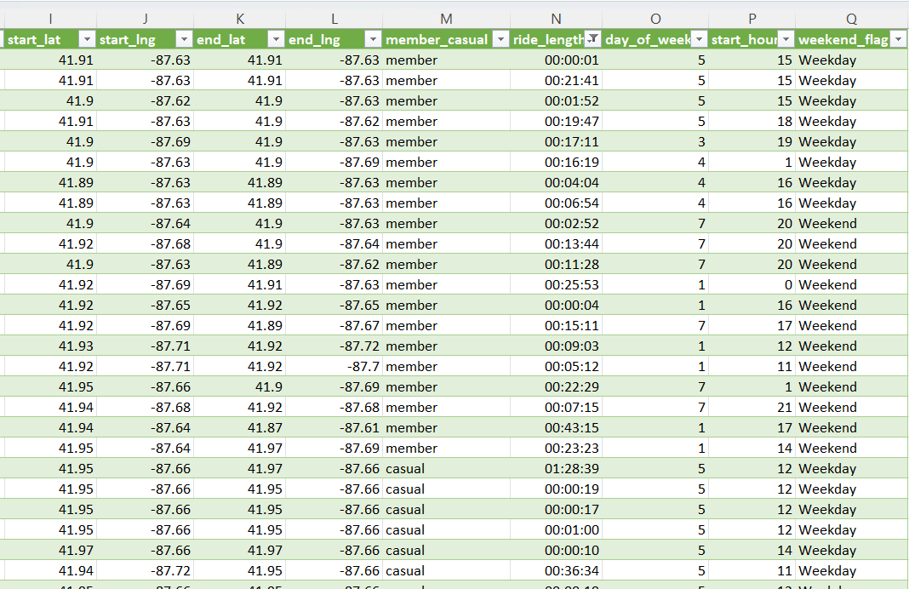



Data Preparation & Cleaning
Raw Dataset:
5.8M+ ride records across 12 months.
Cleaning Steps:
Removed null values & duplicates.
Dropped rides ≤ 0 minutes.
Standardized date, time, and station columns.
Created new fields:
1. ride_length (minutes)
2. ride_date (daily breakdown)
3. weekend_flag (weekday vs weekend)
4. start_hour (time of ride)
Final Dataset:
Clean, structured, and ready for analysis in Power BI.

Slide 4
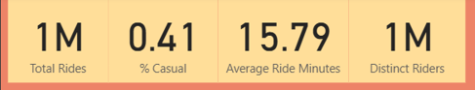
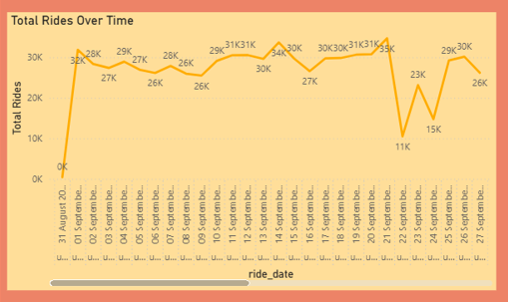
Key Metrics (KPIs)

Slide 5
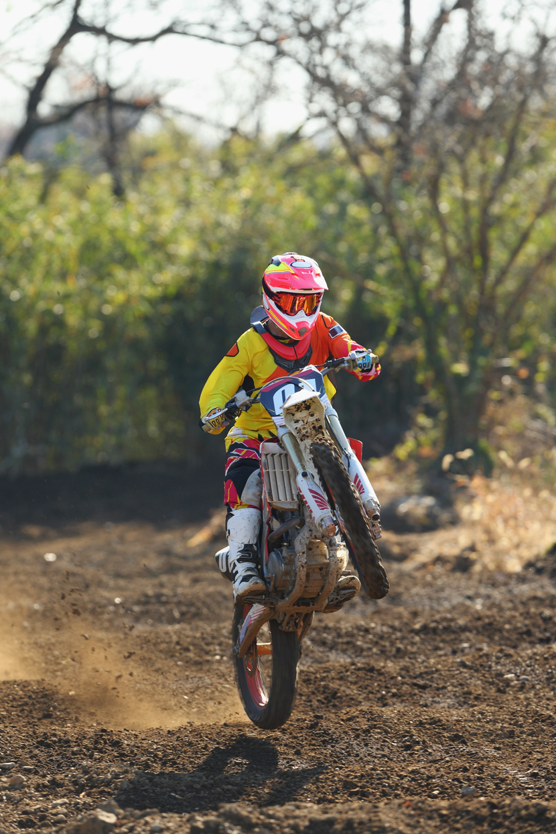
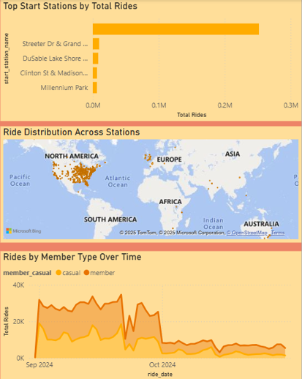
Rider Behavior by Stations & Time
Top Start Stations
Ride Distribution (Map)
Rides by Member Type Over Time
Certain stations dominate ride activity, showing high demand hubs
Usage is concentrated in central and popular areas.
Members ride consistently year-round.
Casual riders show seasonal peaks, especially in warmer months.

Slide 6
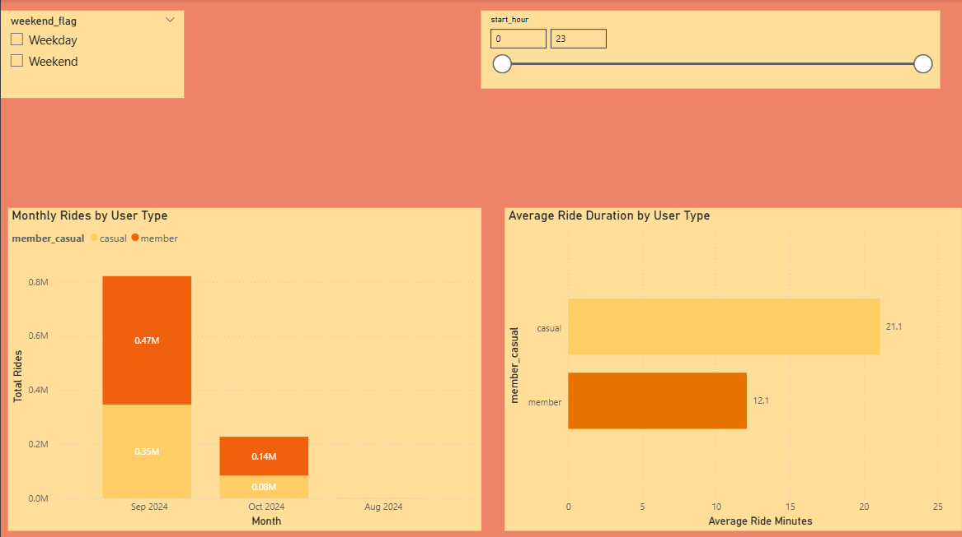
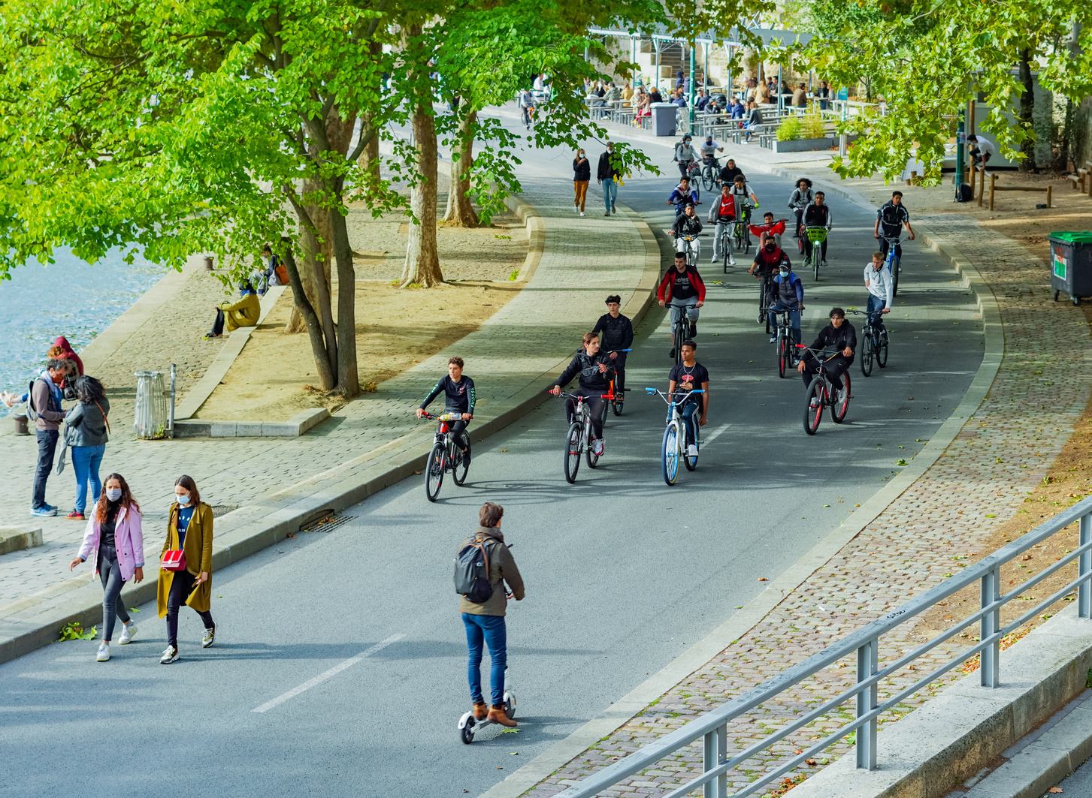
Ride Patterns & Behavior
Monthly Rides: Members ride more consistently, while casual rides peak in summer months.
Average Ride Length: Casual riders take longer trips compared to members.
Weekend vs Weekday: Casual rides increase on weekends, members ride steady throughout the week.
Ride Timing: Peak usage hours are morning (commute) and evening (leisure/return trips).

Slide 7
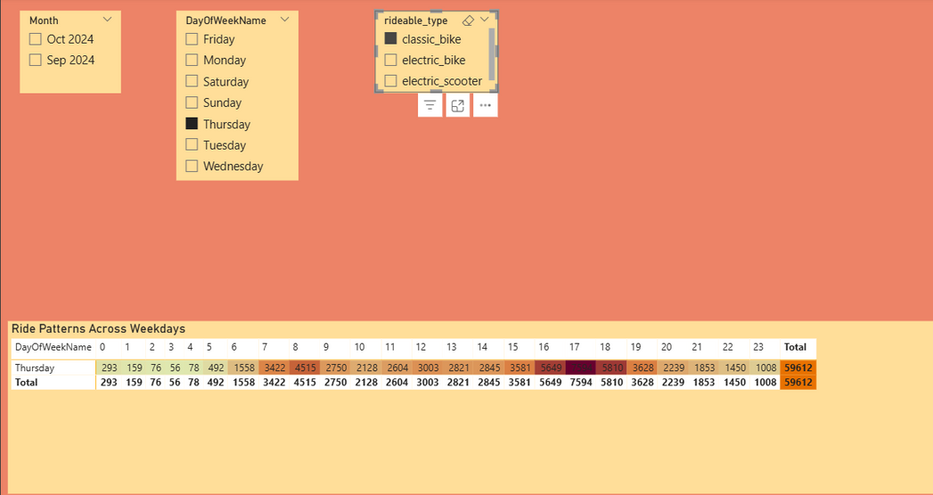
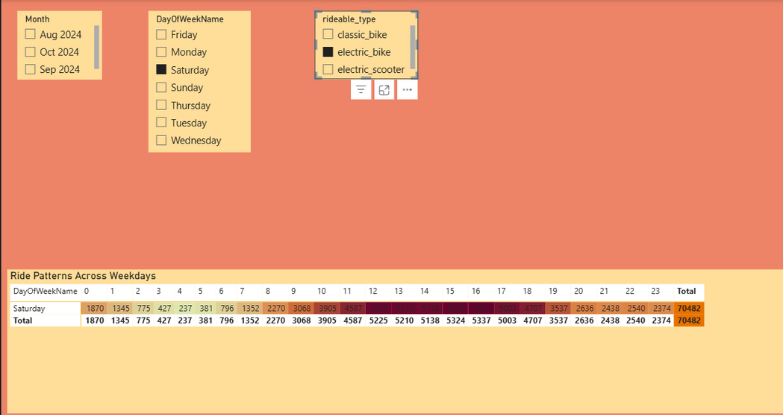
Day & Bike Type Analysis
Rider Trends by Day & Bike Preference
The analysis shows that members dominate weekday rides, while casual riders are more active on weekends, reflecting commuting versus leisure patterns. In terms of bike type, members prefer classic bikes, whereas casual riders often choose electric bikes for shorter, flexible trips. These insights reveal a clear weekday–weekend behavioral split and distinct bike preferences, which can guide targeted marketing and operational strategies.

Slide 8
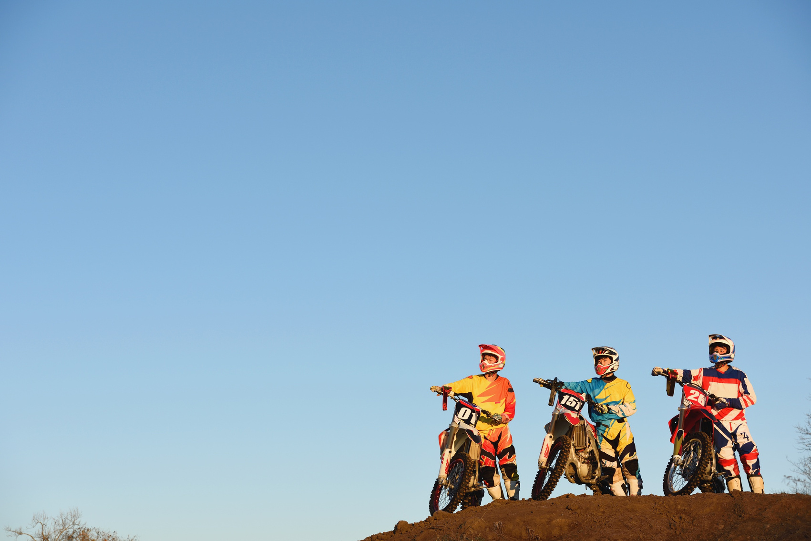
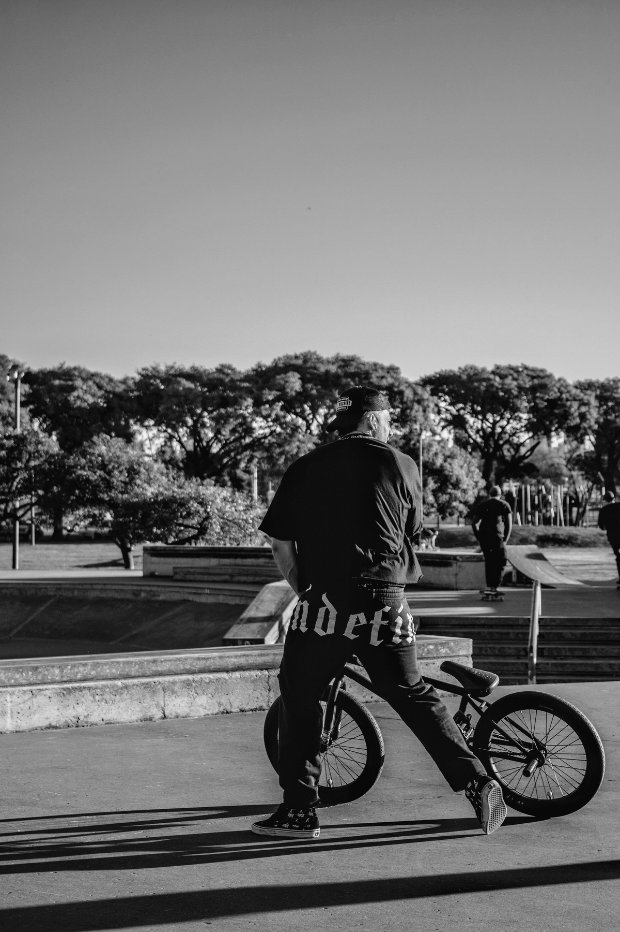
Target casual riders with weekend and seasonal offers.
Promote electric bike memberships for short-trip casual users.
Optimize bike distribution at top-demand stations.
Run weekday commuter campaigns for members.
Use personalized marketing to convert frequent casuals into members.
Recommendations

Slide 9
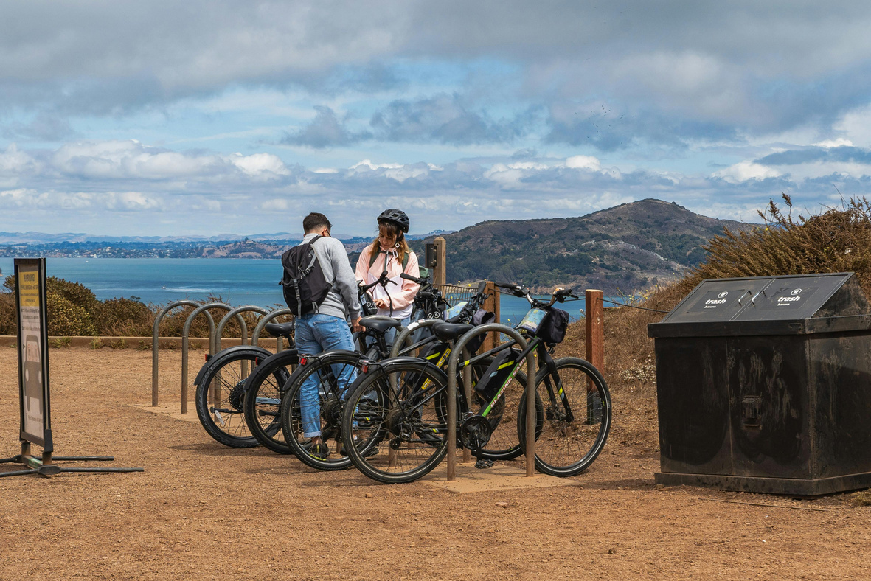

conclusion & future outlook
Casual riders and members show clear differences in trip duration, timing, and bike type preference.
Insights enable Cyclistic to boost membership conversions and improve rider satisfaction.
“Turning casual rides into loyal memberships will drive long-term growth.”

Slide 10
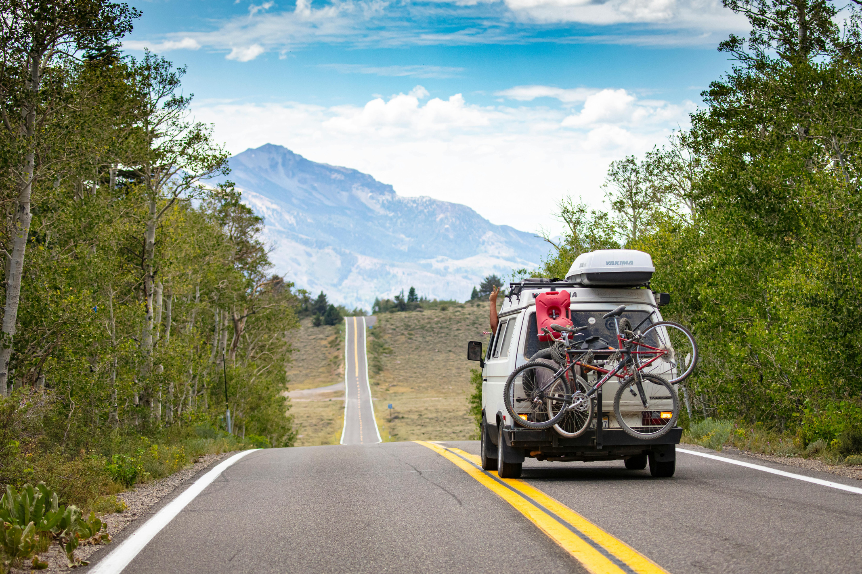



thank you
7206051716
guptarishita139@gmail.com

